Slide 1
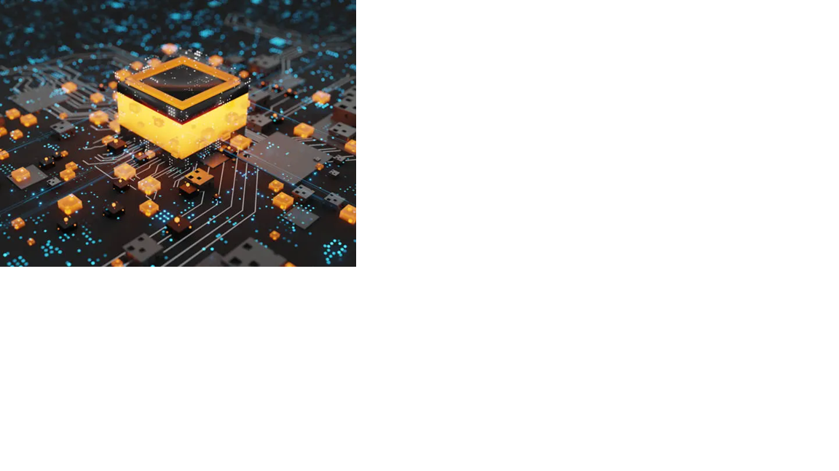

ML 24/25-06 Implement Temporal Memory Parallel Version
Team : Alabaster_Neo
Omkar Salunkhe (1567281)
Adityakumar Chaurasia(1565513)
Ayush Parmar (1565427)

Slide 2
OBJECTIVE
The Temporal Memory (TM) algorithm is currently implemented as a single-threaded process, which limits its performance and scalability. This project enhances efficiency by introducing multithreading, optimizing execution speed and resource usage. Key focus areas include parallelizing iterative loops, implementing concurrency mechanisms, and benchmarking improvements. Existing unit tests will be validated, and new tests introduced to ensure correctness, stability, and robustness

Slide 3
AGENDA
➤ Introduction
➤ Optimization Strategy
➤ Implementation
▶ Single-threaded Init() Method
▶ Implementing Multithreading (Key Changes)
▶ Why Parallel.For is Better Than Async for Matrix Initialization
▶ Implementing Four Optimization Methods
▷ Single-threaded Init()
▷ InitParallelRegularDictionary()
▷ InitParallelWithConcurrentDictionary()
▷ InitParallelPartitioned()
➤ Performance Analysis
➤ Results and Visualization
➤ Final Conclusion

Slide 4
Introduction
Temporal Memory (TM) – Part of HTM, inspired by neocortex
Use Case – Learns & predicts sequential data patterns
Current Limitation – Single-threaded execution, performance bottleneck
Optimization Goal – Implement multithreading, enable parallel execution
Key Benefits – Faster execution, better CPU utilization, improved scalability
Performance Evaluation – Compare single vs. multithreaded, measure speed & efficiency

Slide 5
Optimization Strategies
1.Understanding TM Algorithm 📖
3.Optimization Methods 🚀
2.Parallelizing Code 🔄
4.Performance Analysis 📊
5. Results & Visualization 📈

Slide 6
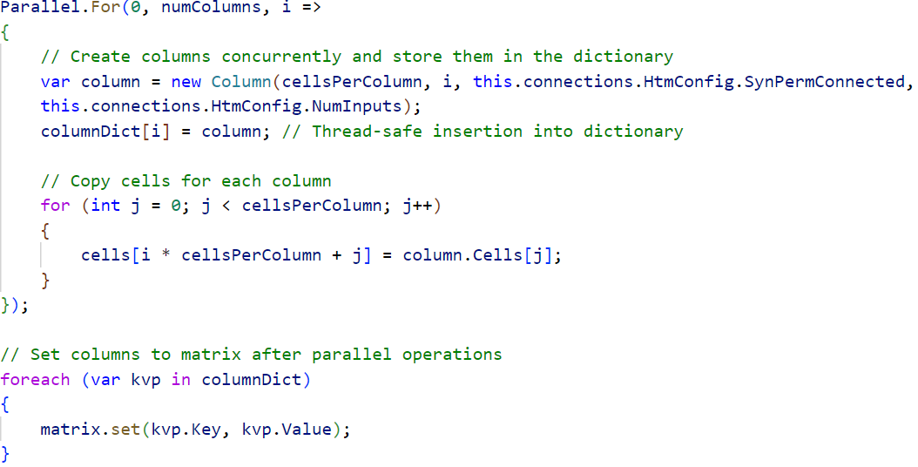
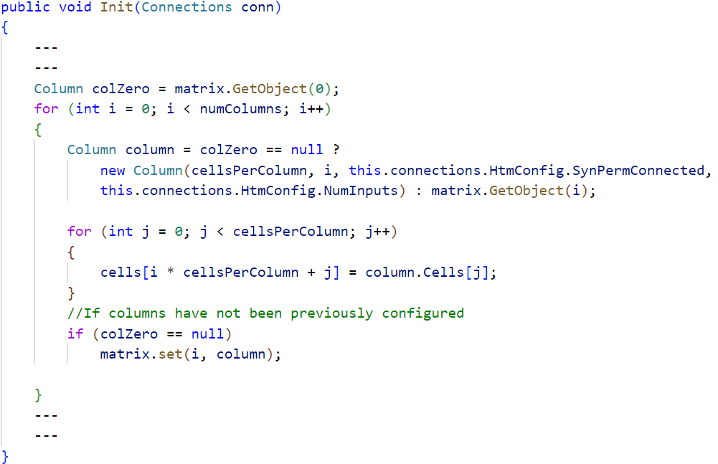
Implementation
Single-threaded Init() Method
Parellel.for
Simple For loop
Implementation of Multithreading (Key Changes)

Slide 7
Why Parallel.For() is Better Than Async for Matrix Initialization
Automatic Load Balancing
Optimized for Short-Lived Tasks
Reduced Synchronization Overhead
No Explicit Thread Management
Dynamic Thread Adjustment
Non-Blocking Execution

Slide 8
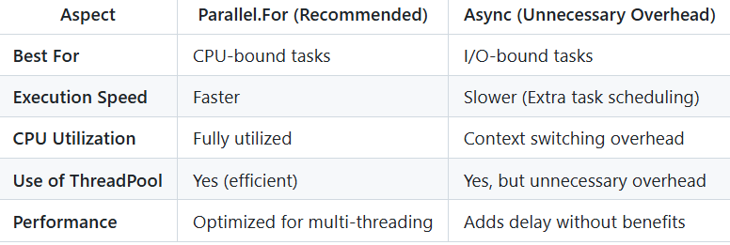

Slide 9
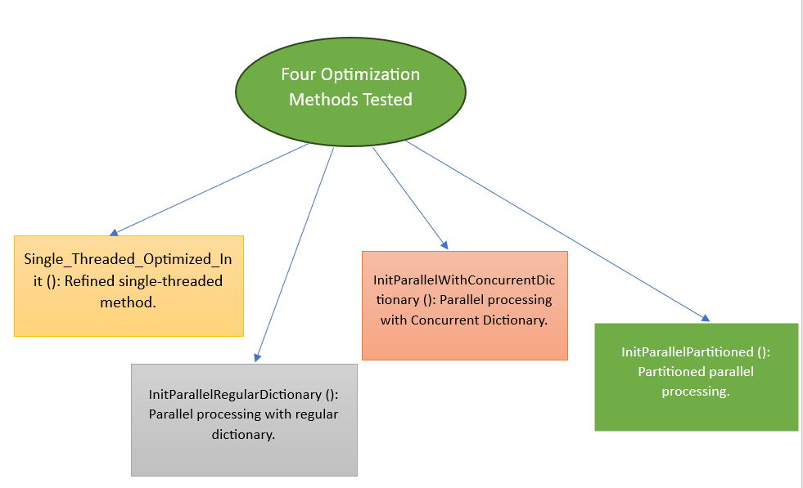
Implementing Four Optimization Methods
InitParallelRegularDictionary()

Slide 10
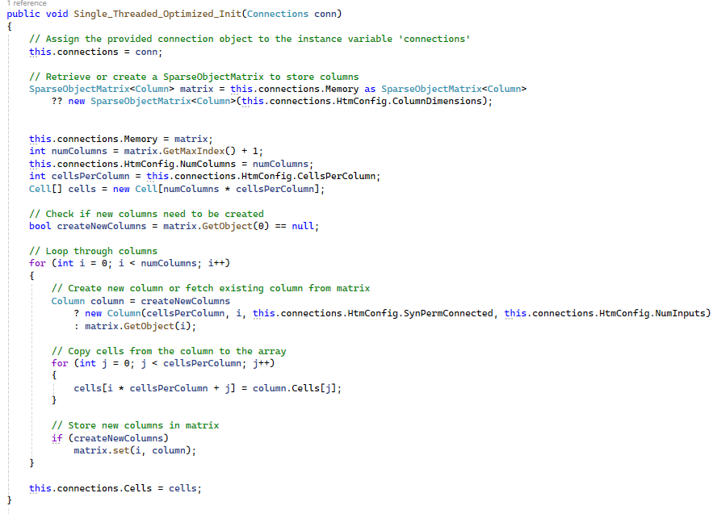
1.Single_Threaded_Optimized_Init()

Slide 11
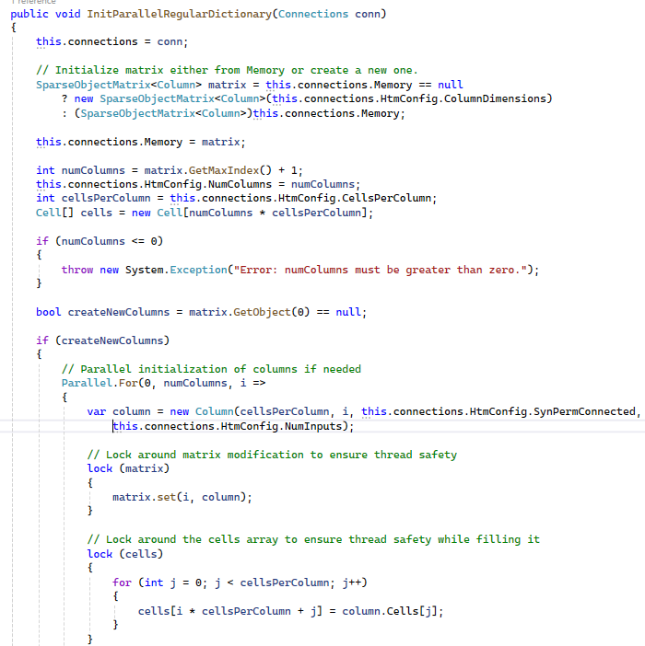
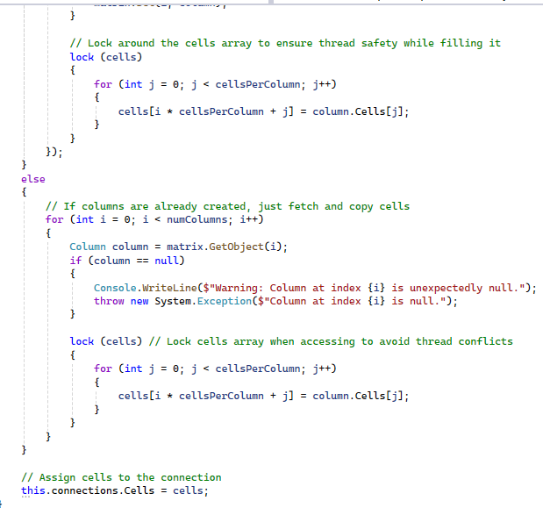

2.InitParallelRegularDictionary()

Slide 12
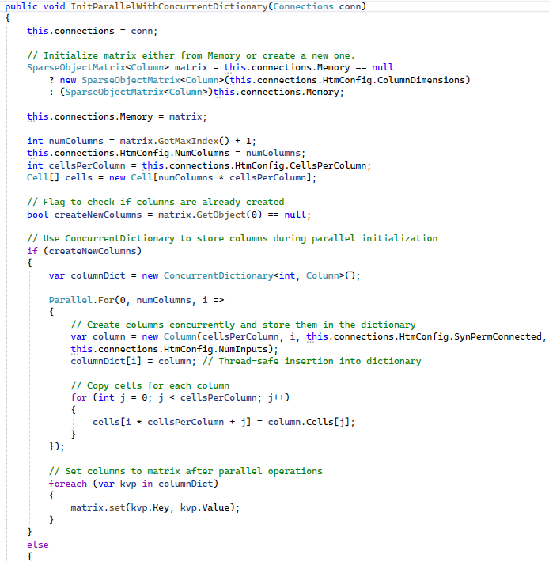
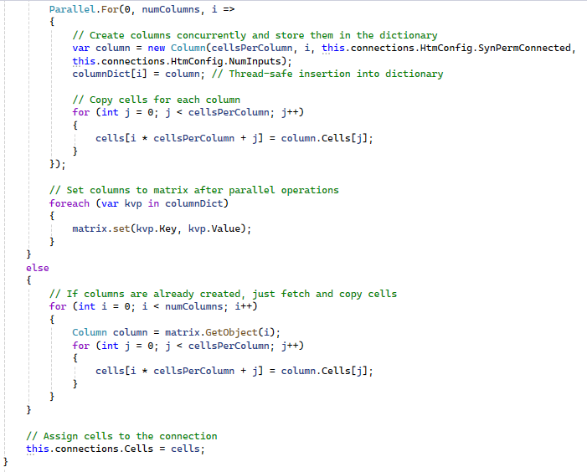


3.InitParallelWithConcurrentDictionary()

Slide 13
Why Use ConcurrentDictionary ?
✅ Thread Safety
✅ Atomic Operations
✅ Lock-Free Operations
✅ Optimized Performance

Slide 14
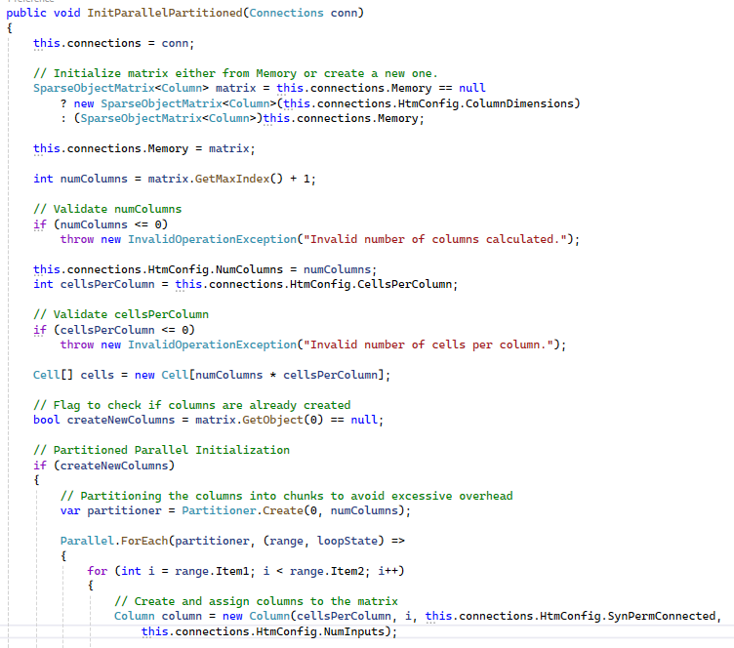
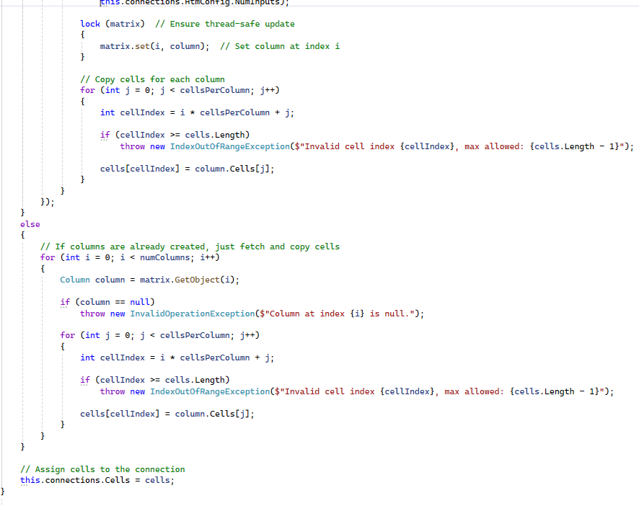



4.InitParallelPartitioned()

Slide 15
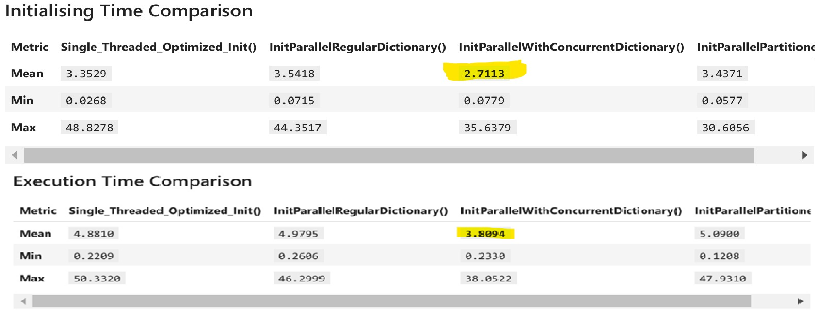
Performance Analysis
1] Key Metrics Calculation for Initialization and Compute Time

Slide 16
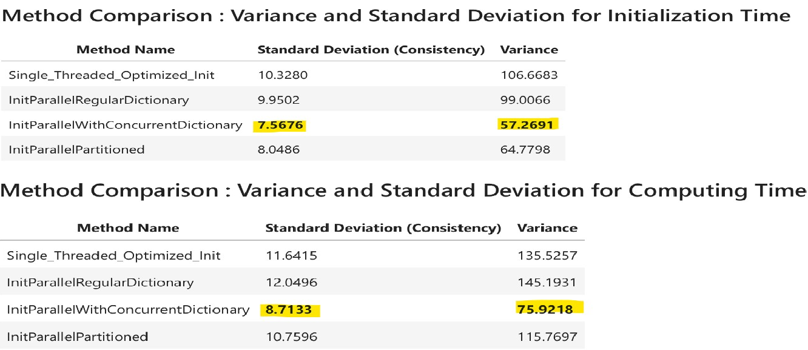
2] Variance and Standard Deviation for Initialization and Compute Time

Slide 17
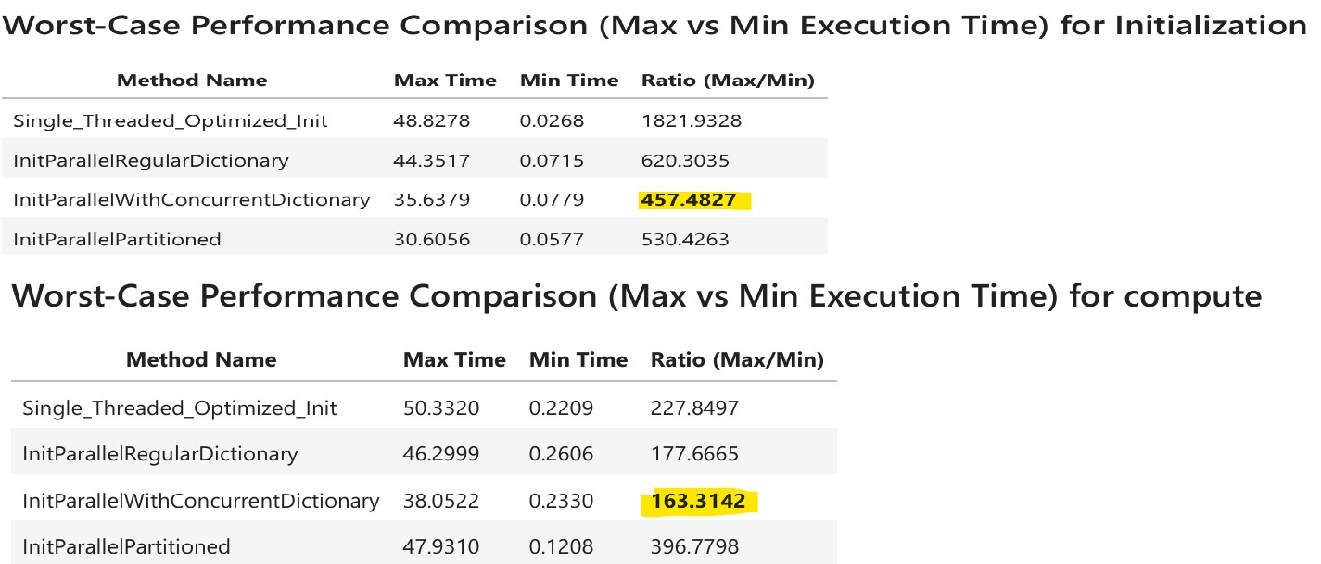
3] Worst-Case Performance Comparison (Max vs Min Time for Initialization and Compute)

Slide 18
Optimal Method Selection
Method Selection
Mean Execution Time (Low Mean)
Consistent Performance (Low variance)
Predictable Stability (Low Max/Min ratio)
Initializing Mean Value: 2.7113
Execution Mean Value: 3.8094
Max/Min ratio for Initialization: 457.4827
Max/Min ratio for Compute: 163.3142
Variance for Initializing Time: 57.2691
Variance for Computing Time: 75.9218

Slide 19
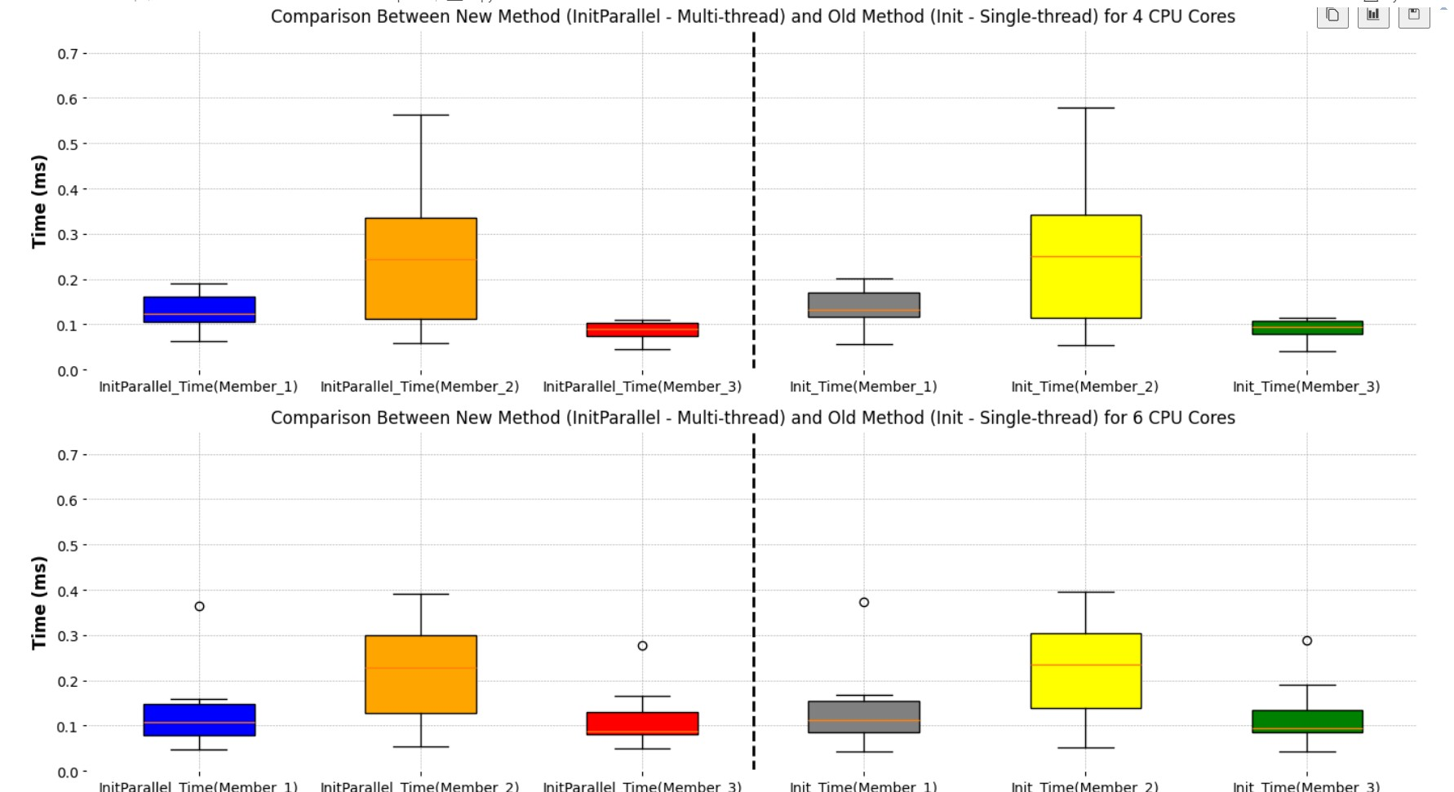
Result and Visualizations
Visualizing Performance Data for InitParallelWithConcurrentDictionary()
Performance Comparison of both the new multi-threaded method (InitParallelWithConcurrentDictionary()) and the old single-threaded method (Init()) across various CPU configurations (4, 6, 8, 10, and All cores) on different PCs.
1] Performance Comparison for 4 and 6 Cores

Slide 20
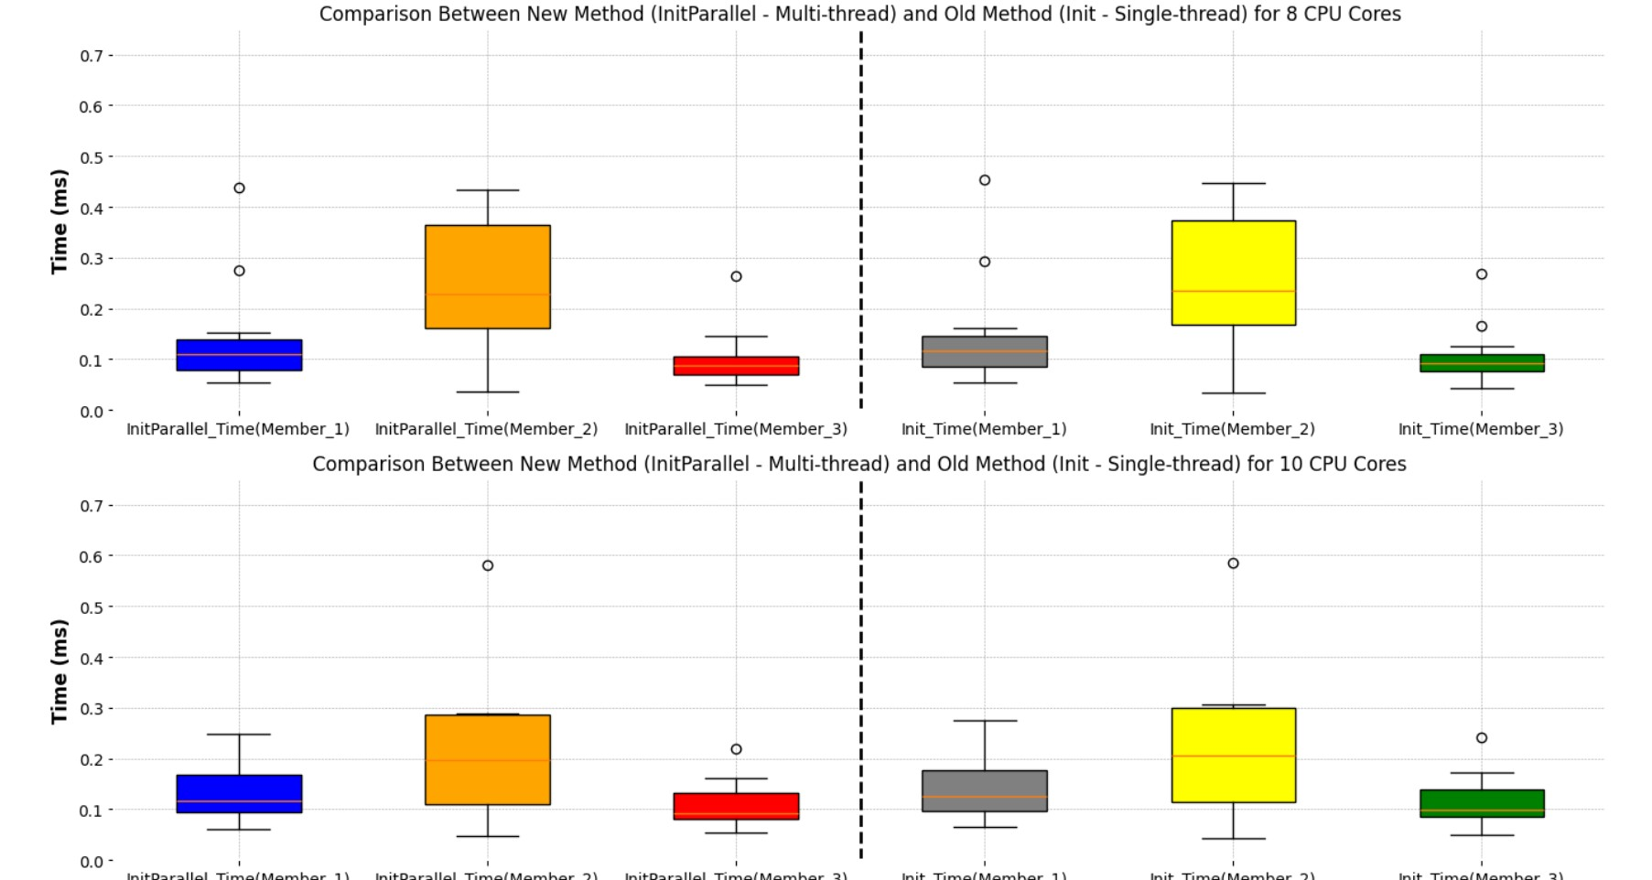
2] Performance Comparison for 8 and 10 Cores

Slide 21
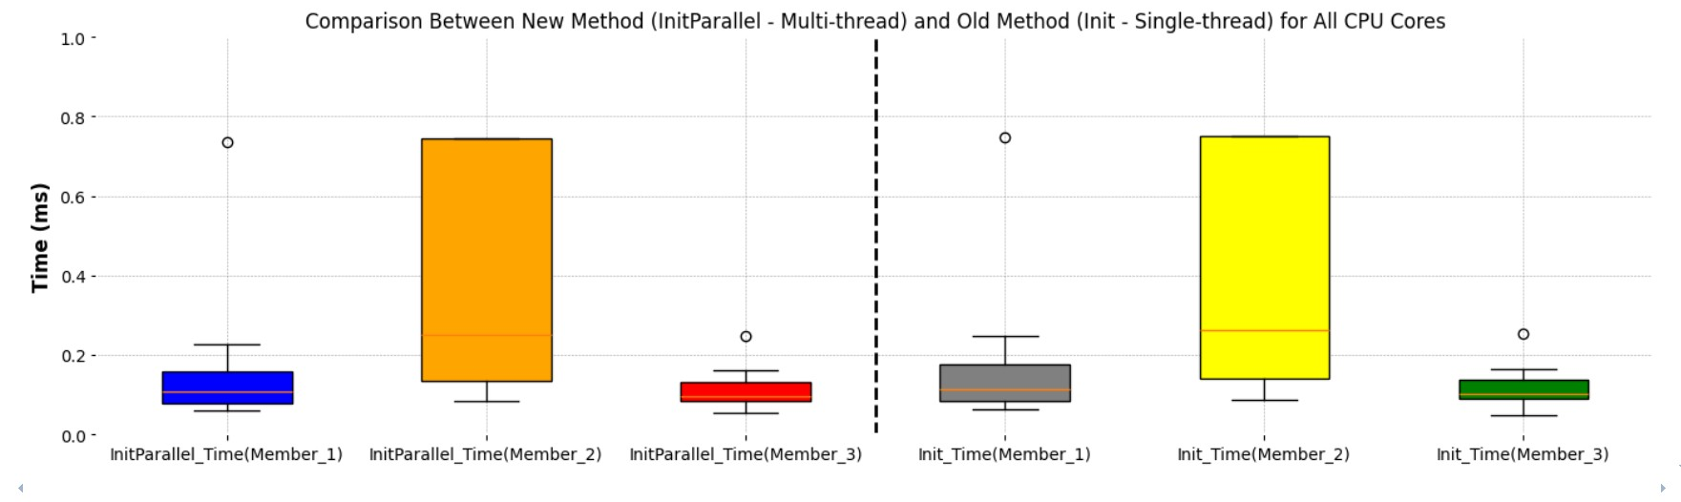
3] Performance Comparison for All Cores

Slide 22
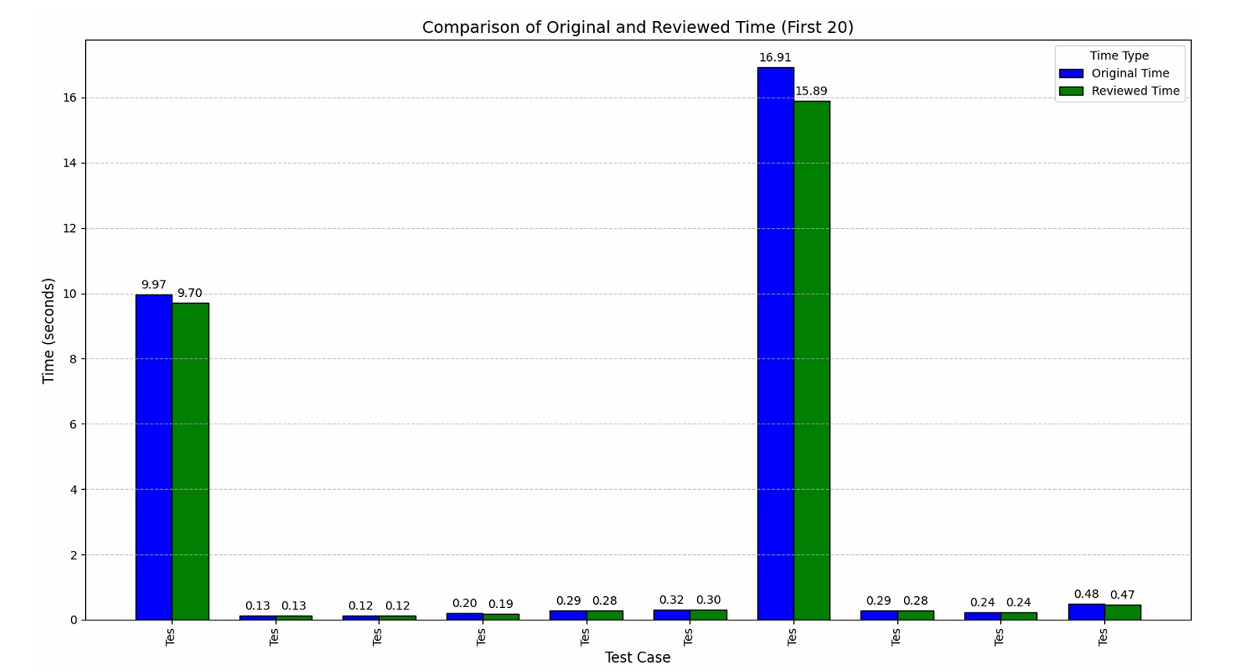
Comparing both Initialization Times and Computation Times across different test cases
Chart compares the initialization performance between standard and parallel methods for each test cases.

Slide 23
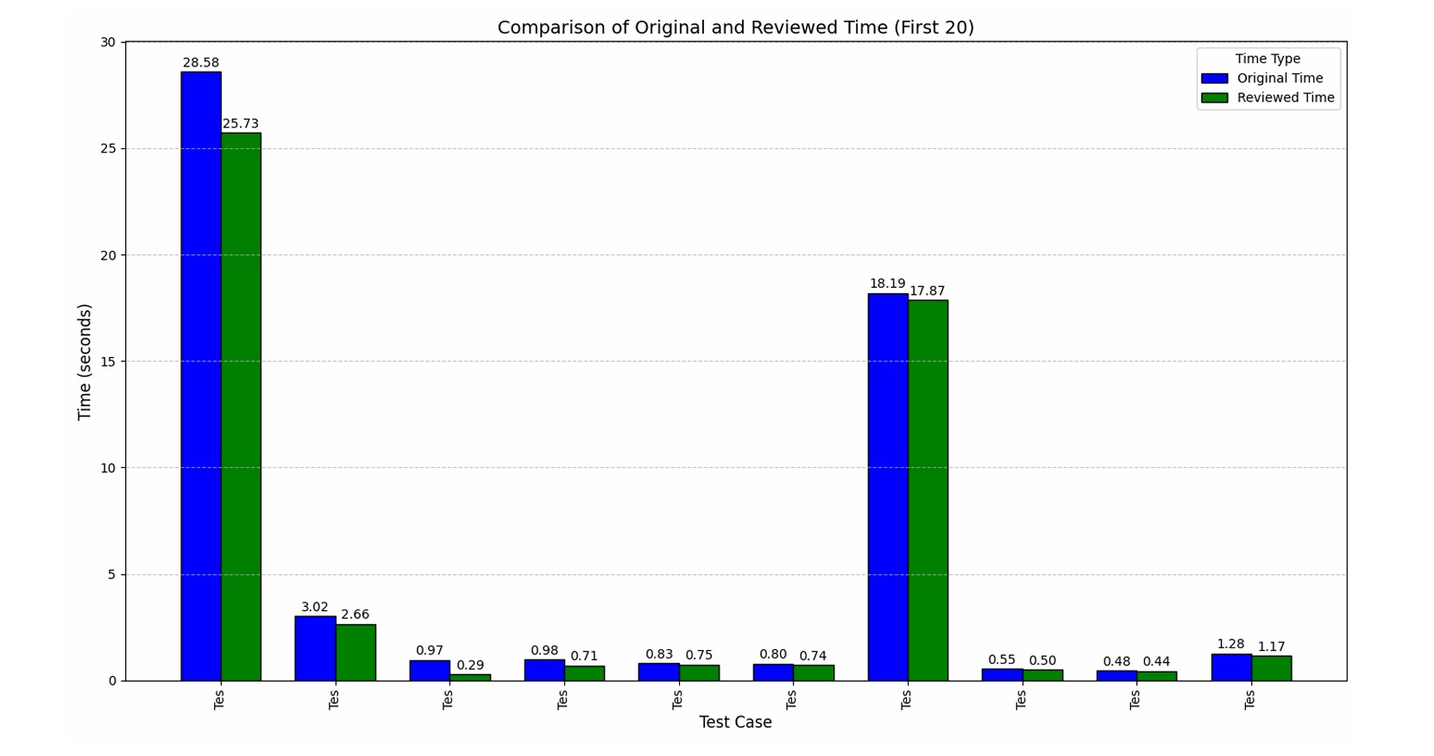
Chart compares the computation performance between standard and parallel methods for each test cases.

Slide 24
Conclusion
This project successfully optimized the Temporal Memory (TM) algorithm by implementing multithreading, significantly improving performance and scalability.
By leveraging Parallel.For, ConcurrentDictionary, and partitioned execution, we achieved reduced execution time, improved CPU utilization, and enhanced system efficiency.
Among the tested methods, InitParallelWithConcurrentDictionary() proved the most efficient, delivering the best balance of speed and stability.
These optimizations lay the foundation for future advancements, including GPU acceleration and hybrid parallelization, to further enhance real-time processing capabilities.
The output has been demonstrated appropriately showcasing relevant parameters

Slide 25


